Slide 1



BCSE0004: Operating Systems
Deadlock in Operating Systems
Lecture by Ms. Ambika Gupta

Slide 2
Agenda
The Deadlock Problem
System Model
Deadlock Characterization
Resource Allocation Graph

Slide 3
Deadlock
Deadlock is a situation where a set of processes are blocked because each process is holding a resource and waiting for another resource acquired by some other process.

Slide 4
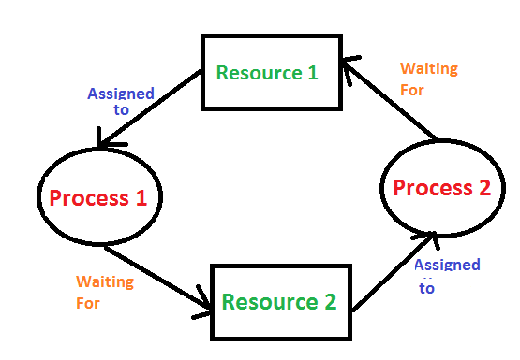
Contd…

Slide 5
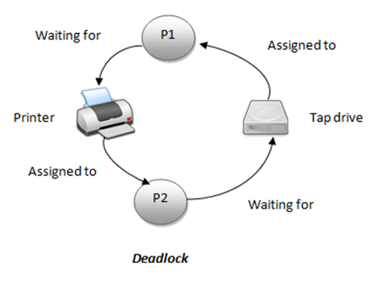
Contd…

Slide 6
Important Notes about Deadlock
In deadlock, processes get blocked because each process is holding some resource and they are waiting for other resource , which is held by another process.
Deadlock usually occurs in multiprocessing, time- sharing etc.

Slide 7
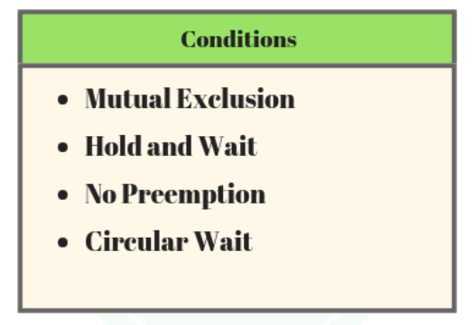
Conditions for Deadlock
Deadlock can occur if all the given 4 conditions (Coffman Conditions) are satisfied, that is if all are true :

Slide 8
Contd..
Mutual exclusion – If At least one or more resource are in non shareable mode , the resources should be in mutual exclusion.

Slide 9
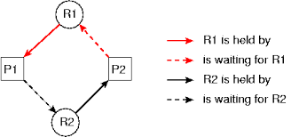
Contd..
Hold and Wait – Processes which are already holding at least 1 resource may request new resource.

Slide 10
Contd..
No Pre-emption – Resources can’t be released by force , only the process holding the resource can release it, which does so after the process has finished its task.

Slide 11
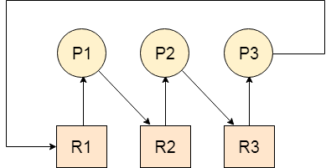
Contd..
Circular wait – 2 or more process form a circular chain where each process waits and want to acquire the resource which the next process in the chain holds.

Slide 12
Resource Allocation Graph (RAG)
Deadlock can be described more precisely in the term of directed graph called Resource Allocation Graph.

Slide 13
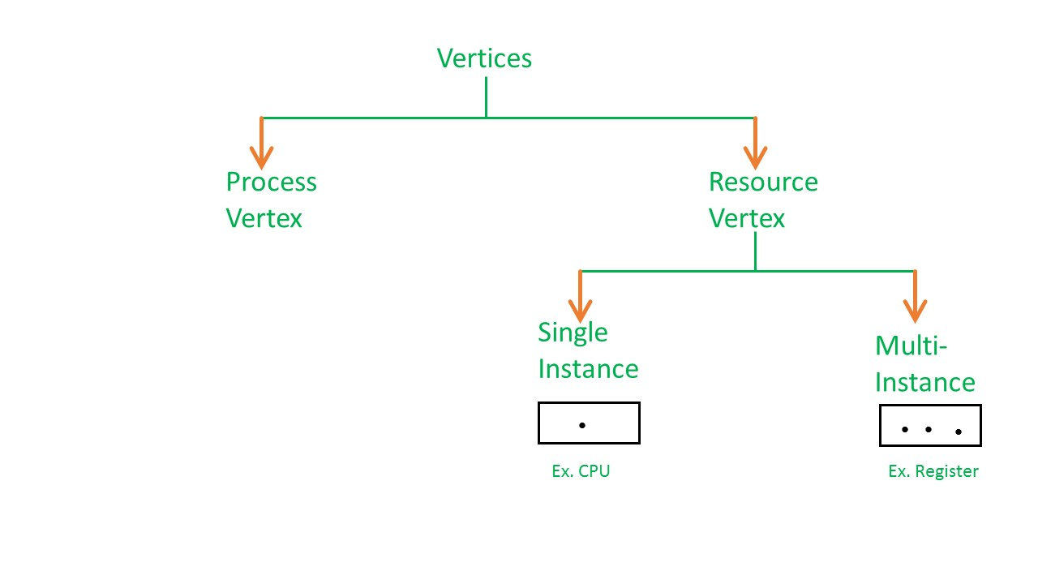
Resource Allocation Graph (RAG)
In RAG vertices are of two types –

Slide 14
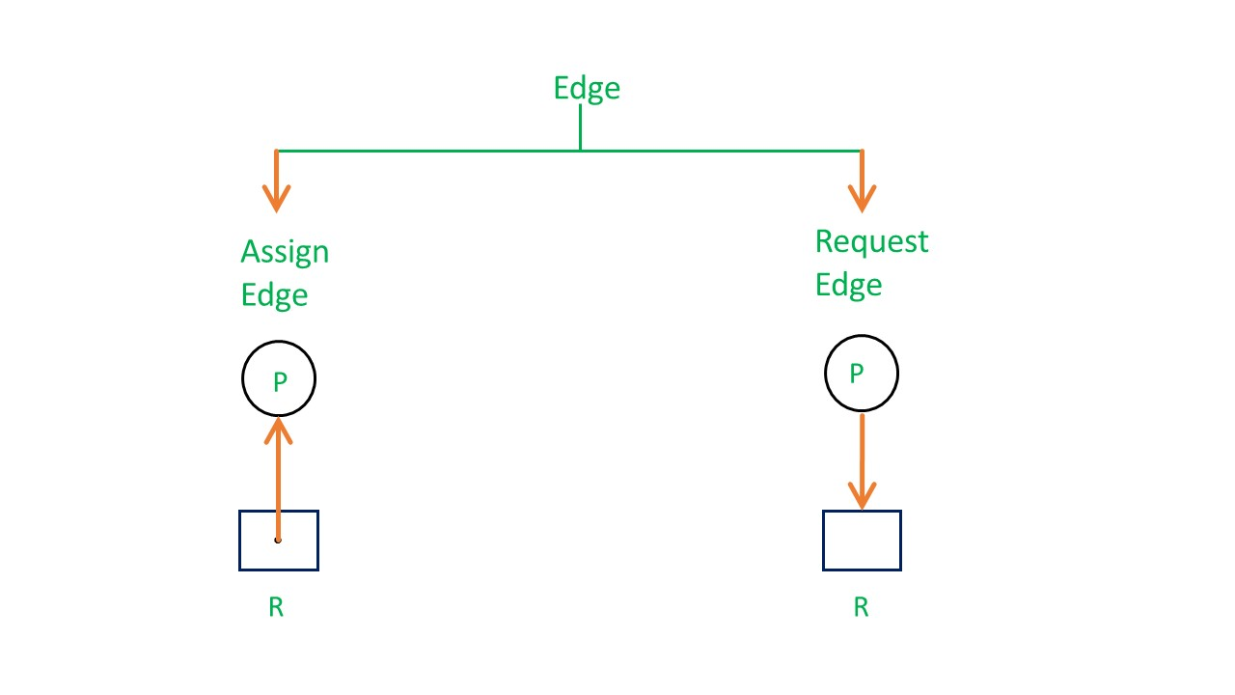
Resource Allocation Graph (RAG)
In RAG edges are of two types –

Slide 15
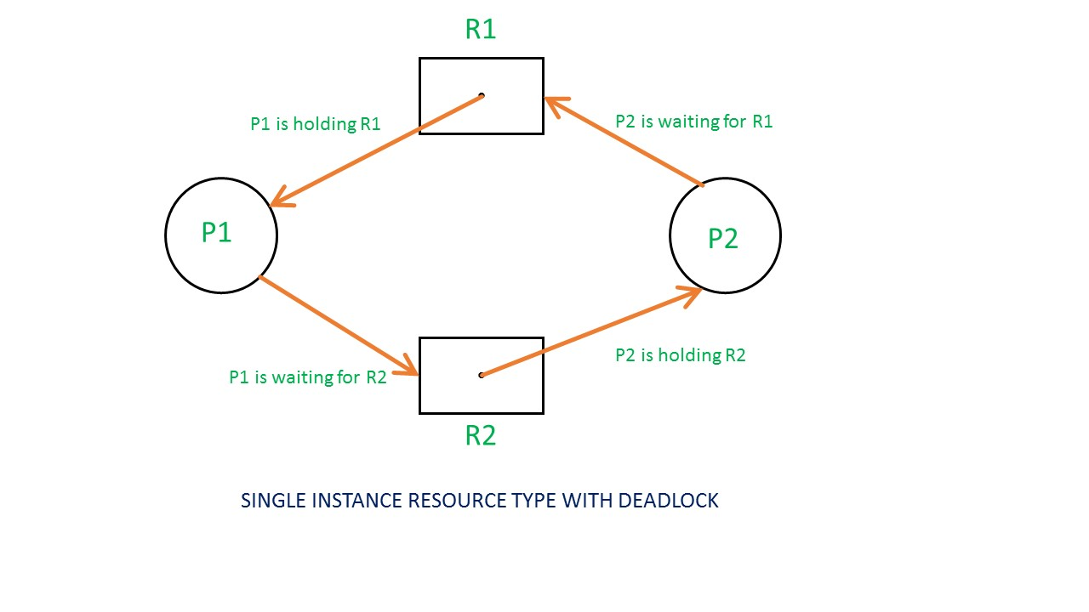
Resource Allocation Graph (RAG)

Slide 16
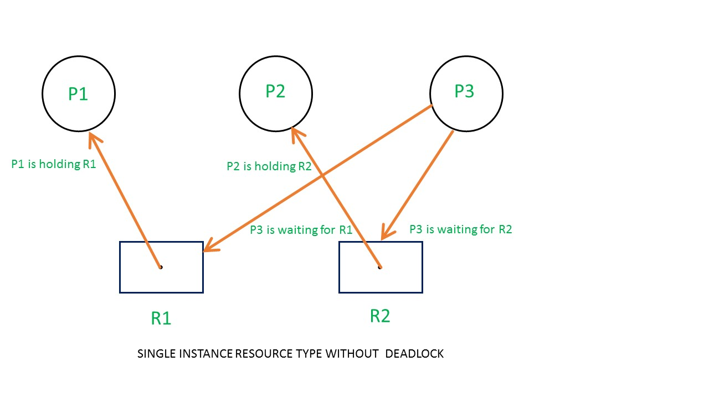
Resource Allocation Graph (RAG)

Slide 17
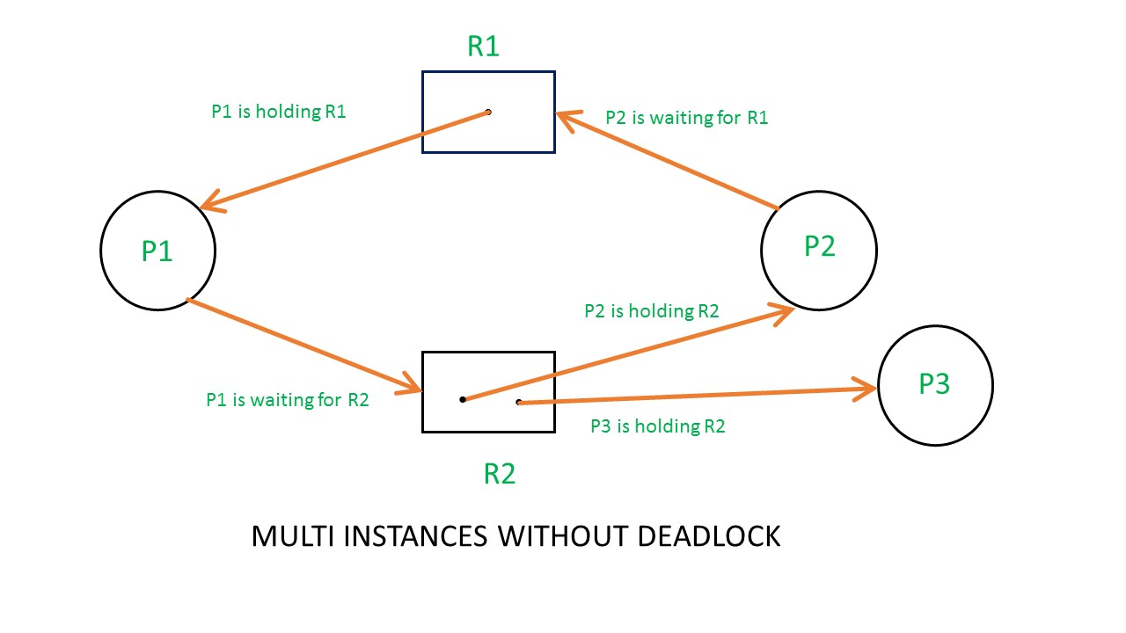
Resource Allocation Graph (RAG)

Slide 18


